Slide 1
Roadmap of the MVAPICH Project
A Presentation at SC’23
Presented by
Hari Subramoni and Nathaniel Shineman
The MVAPICH Team
The Ohio State University
http://mvapich.cse.ohio-state.edu/

Slide 2
Outline
Brief Overview of the MVAPICH Project
Features of Latest Release
MVAPICH 3.0rc
MVAPICH-Plus 3.0b
Converged software stack based on MVAPICH
Support for DL (HiDL), ML (MPI4cuML), Big Data (MPI4Spark), and Data Science (MPI4Dask)
OSU Micro-Benchmarks (OMB)
Upcoming Features
MVAPICH and MVAPICH-Plus 4.0 series with support for MPI 4.1
MVAPICH-Plus for AI-Accelerator Chips (Habana/Gaudi)
MVAPICH and OMB for FPGA
MPI4DL for Deep Learning
Conclusions

Slide 3
Overview of the MVAPICH2 Project
High Performance open-source MPI Library
Support for multiple interconnects
InfiniBand, Omni-Path, Ethernet/iWARP, RDMA over Converged Ethernet (RoCE), AWS EFA, OPX, Broadcom RoCE, Intel Ethernet, Rockport Networks, Slingshot 10/11
Support for multiple platforms
x86, OpenPOWER, ARM, Xeon-Phi, GPGPUs (NVIDIA and AMD)
Started in 2001, first open-source version demonstrated at SC ‘02
Supports the latest MPI-3.1 standard
http://mvapich.cse.ohio-state.edu
Additional optimized versions for different systems/environments:
MVAPICH2-X (Advanced MPI + PGAS), since 2011
MVAPICH2-GDR with support for NVIDIA (since 2014) and AMD (since 2020) GPUs
MVAPICH2-MIC with support for Intel Xeon-Phi, since 2014
MVAPICH2-Virt with virtualization support, since 2015
MVAPICH2-EA with support for Energy-Awareness, since 2015
MVAPICH2-Azure for Azure HPC IB instances, since 2019
MVAPICH2-X-AWS for AWS HPC+EFA instances, since 2019
Tools:
OSU MPI Micro-Benchmarks (OMB), since 2003
OSU InfiniBand Network Analysis and Monitoring (INAM), since 2015
Used by more than 3,325 organizations in 90 countries
More than 1.74 Million downloads from the OSU site directly
Empowering many TOP500 clusters (Jun ‘23 ranking)
7th , 10,649,600-core (Sunway TaihuLight) at NSC, Wuxi, China
21st , 448, 448 cores (Frontera) at TACC
36th, 288,288 cores (Lassen) at LLNL
49th, 570,020 cores (Nurion) in South Korea and many others
Available with software stacks of many vendors and Linux Distros (RedHat, SuSE, OpenHPC, and Spack)
Partner in the 21st ranked TACC Frontera system
Empowering Top500 systems for more than 16 years

Slide 4
Architecture of MVAPICH Software Family for HPC, DL/ML, Big Data & Data Science
High Performance Parallel Programming Models
Message Passing Interface
(MPI)
PGAS
(UPC, OpenSHMEM, CAF, UPC++)
Hybrid --- MPI + X
(MPI + PGAS + OpenMP/Cilk)
High Performance and Scalable Communication Runtime
Diverse APIs and Mechanisms
Point-to-point Primitives
Collectives Algorithms
Job Startup
Energy-
Awareness
Remote Memory Access
I/O and
File Systems
Fault
Tolerance
Virtualization
Active Messages
Introspection & Analysis
Support for Modern Networking Technology
(InfiniBand, iWARP, RoCE, Omni-Path, Elastic Fabric Adapter)
Support for Modern Multi-/Many-core Architectures
(Intel-Xeon, OpenPOWER, Xeon-Phi, ARM, NVIDIA/AMD GPGPU)
Transport Protocols
Modern Features
Transport Mechanisms
Modern Features
RC
SRD
UD
DC
UMR
ODP
SR-IOV
Multi Rail
Shared Memory
CMA
IVSHMEM
XPMEM
Optane*
NVLink
CAPI*
* Upcoming

Slide 5
Outline
Brief Overview of the MVAPICH Project
Features of Latest Release
MVAPICH 3.0rc
MVAPICH-Plus 3.0b
Converged software stack based on MVAPICH
Support for DL (HiDL), ML (MPI4cuML), Big Data (MPI4Spark), and Data Science (MPI4Dask)
OSU Micro-Benchmarks (OMB)
Upcoming Features
Conclusions

Slide 6
MVAPICH 3.0
RC version released 11/09/2023
Major Features and Enhancements in 3.0 series
Based on MPICH 3.4.3
Support for OFI and UCX network libraries through MPICH netmod interface
MVAPICH enhanced collective designs
Support for Cray Slingshot 11 network
Improved CVAR interface for consistency and performance
Support for SHARP

Slide 7
MPI Level Latency on Slingshot 11
Small message Latency
Medium/Large message Latency
2us inter-node point-to-point latency for small messages
Interconnect : Cray HPE Slingshot 11
Library : MVAPICH 3.0a
CPU : AMD EPYC 7763 (milan) Processor

Slide 8
MPI Level Bandwidth on Slingshot 11
Uni-directional Bandwidth
Bi-Directional Bandwidth
23,985 MB/s uni-directional peak bandwidth
42,034 MB/s bi-directional peak bandwidth
Interconnect : Cray HPE Slingshot 11 (200 Gbps)
Library : MVAPICH 3.0a
CPU : AMD EPYC 7763 (milan) Processor

Slide 9
MVAPICH2-3.0a+OPX vs MVAPICH2-2.3.7+PSM2 (Early Performance Results)
1.69x
1.22 us
1.08 us
System: Intel Xeon Bronze (Skylake) 3106 CPU @ 1.70GHz (4 nodes, 16 cores/node, 8 x 2 sockets) with Omni-Path 100Gbps

Slide 10
AMD Milan + HDR 200
Intra-Node CPU Point-to-Point
Latency
Bandwidth
31.8GB/s
Inter-Node CPU Point-to-Point
Latency
Bandwidth
AMD EPYC 7V73X 64-Core Processor, Mellanox ConnectX-6 HDR HCA

Slide 11
MVAPICH2-Plus: One Stack for all Architectures and Interconnects
MVAPICH2-GDR
MVAPICH2-X
MVAPICH2-AWS
MVAPICH2-Plus
Various libraries are being merged into one release
Simplifies installation and deployment
Enables utilizing the best advanced features for all architectures
Contains bleeding edge designs

Slide 12
Outline
Brief Overview of the MVAPICH Project
Features of Latest Release
MVAPICH 3.0b
MVAPICH-Plus 3.0rc
Converged software stack based on MVAPICH
Support for DL (HiDL), ML (MPI4cuML), Big Data (MPI4Spark), and Data Science (MPI4Dask)
OSU Micro-Benchmarks (OMB)
Upcoming Features
Conclusions

Slide 13
MVAPICH-Plus 3.0
Latest Beta Release 11/01/2023
Major Features and Enhancements
Based on MVAPICH 3.0
Supports all networks types supported by
Support for AMD and NVIDIA GPUs
Support for MVAPICH enhanced GPU Collectives
Support for enhanced GPU pt2pt operations
GDRCOPY, AMD LargeBar memcopy, GPU IPC
Support for on-the-fly compression

Slide 14
MVAPICH-PLUS with AMD LargeBar Design on AMD GPUs
Latency:
TIOGA - AMD MI250 GPUs
MRI - AMD MI100 GPUs

Slide 15
MVAPICH-PLUS GPU Optimized for Collectives – NVIDIA + IB
MPI_Gather:
MPI_Scatter:
MPI_Alltoall:
NVIDIA A100 GPUs ( 8 GPUS – 4 Nodes, 2 GPUs per Node) + CUDA 12.0

Slide 16
MVAPICH-PLUS GPU Optimized for Collectives – AMD + Slingshot-11
MPI_Gather:
MPI_Scatter:
MPI_Alltoall:
AMD MI250 GPUs ( 16 GPUS – 2 Nodes, 8 GPUs per Node) + ROCm 5.1.0

Slide 17
“On-the-fly” Compression Support in MVAPICH-Plus
Weak-Scaling of HPC application AWP-ODC on Lassen cluster (V100 nodes)
MPC-OPT achieves up to +18% GPU computing flops, -15% runtime per timestep
ZFP-OPT achieves up to +35% GPU computing flops, -26% runtime per timestep
-15%
+18%
-26%
+35%
Q. Zhou, C. Chu, N. Senthil Kumar, P. Kousha, M. Ghazimirsaeed, H. Subramoni, and D.K. Panda, Designing High-Performance MPI Libraries with On-the-fly Compression for Modern GPU Clusters, 35th IEEE International Parallel & Distributed Processing Symposium (IPDPS), May 2021. [Best Paper Finalist]

Slide 18
Performance of All-to-All with Online Compression
29.2%
35.8%
Improvement compared to MVAPICH2-GDR-2.3.7 with Point-to-Point compression
3D-FFT: Reduce All-to-All runtime by up to 29.2% with ZFP(rate: 24) on 64 GPUs
DeepSpeed benchmark: Reduce All-to-All runtime by up to 35.8% with ZFP(rate: 16) on 32 GPUs
Q. Zhou, P. Kousha, Q. Anthony, K. Khorassani, A. Shafi, H. Subramoni, and D.K. Panda, “Accelerating MPI All-to-All Communication with Online Compression on Modern GPU Clusters”, ISC ’22.
Available in MVAPICH2-GDR 2.3.7

Slide 19
Outline
Brief Overview of the MVAPICH Project
Features of Latest Release
MVAPICH 3.0rc
MVAPICH-Plus 3.0b
Converged software stack based on MVAPICH
Support for DL (HiDL), ML (MPI4cuML), Big Data (MPI4Spark), and Data Science (MPI4Dask)
OSU Micro-Benchmarks (OMB)
Upcoming Features
Conclusions

Slide 20
MPI-Driven Solutions for AI, Big Data and Data Science
Deep/
Machine Learning (TensorFlow, PyTorch, cuML, etc.)
Big Data (Hadoop, Spark), Data Science (Dask)
HPC (MPI, PGAS, etc.)
Convergence of HPC, Deep/Machine Learning, and Data Science!

Slide 21
Four Different Modules
Deep Learning (HiDL)
Machine Learning (MPI4cuML)
Big Data (MPI4Spark)
Data Science (MPI4Dask)

Slide 22
MVAPICH (MPI)-driven Infrastructure for ML/DL Training
ML/DL Applications
ML/DL Applications
TensorFlow
PyTorch
MXNet
PyTorch
Horovod
Torch.distributed
DeepSpeed
MVAPICH or MVAPICH-Plus for CPU Training
MVAPICH-Plus for
GPU Training
MVAPICH or MVAPICH-Plus for CPU Training
MVAPICH-Plus for
GPU Training
More details available from: http://hidl.cse.ohio-state.edu

Slide 23
Outline
Brief Overview of the MVAPICH Project
Features of Latest Release
MVAPICH 3.0rc
MVAPICH-Plus 3.0b
Converged software stack based on MVAPICH
Support for DL (HiDL), ML (MPI4cuML), Big Data (MPI4Spark), and Data Science (MPI4Dask)
OSU Micro-Benchmarks (OMB)
Upcoming Features
Conclusions

Slide 24
OSU Microbenchmarks
Available since 2004
Suite of microbenchmarks to study communication performance of various programming models
Benchmarks available for the following programming models
Message Passing Interface (MPI)
Partitioned Global Address Space (PGAS)
Unified Parallel C (UPC), Unified Parallel C++ (UPC++), and OpenSHMEM
Benchmarks available for multiple accelerator-based architectures
Compute Unified Device Architecture (CUDA)
OpenACC Application Program Interface
Part of various national resource procurement suites like NERSC-8 / Trinity Benchmarks
Continuing to add support for newer primitives and features (since OMB 6.0)
Java Binding Support
Python Support
Please visit the following link for more information: http://mvapich.cse.ohio-state.edu/benchmarks/

Slide 25
OSU Micro Benchmarks v7.3
New features since SC '22
Add MPI-4 session based initialization support to the following benchmarks
Pt2pt, Collective, One-sided, Neighborhood
Add an option to set root rank for rooted blocking and non-blocking collectives
Add new blocking and non-blocking neighborhood collective benchmarks with support for CPU buffers
Add new benchmarks for point-to-point persistent communication primitives
Add support for benchmarking non-blocking Reduce-Scatter
Add RCCL support through unified XCCL interface
Added support for persistent point-to-point and collective operations
Add support for new metrics
Median, 90th, and 99th percentile tail latency

Slide 26
Outline
Brief Overview of the MVAPICH Project
Features of Latest Release
Upcoming Features
MVAPICH and MVAPICH-Plus 4.0 with support for MPI 4.1
MVAPICH-Plus for AI-Accelerator Chips (Habana/Gaudi)
MVAPICH and OMB for FPGA
MPI4DL for Deep Learning
Conclusions

Slide 27
MVAPICH – Moving to MPI 4.1
MPI 4.1 released early this month
4.0 released last year
MPICH support for MPI 4.1 coming soon
MVAPICH total re-write for MPICH 4.2+
Migrating MVAPICH to a "rolling update" model to keep up with the latest features in MPICH
Regular syncing with upstream MPICH to keep current with the community and the standard
Regular attendance at MPICH developer meetings
Integrated optimizations that "play nice" with existing designs
Enhanced shared memory optimizations, tuning, and new IB netmod
Leveraging 23 years of experience in IB networking

Slide 28
MVAPICH 4.0 Release Timeline
Q1 2024 – MVAPICH-Plus 4.0 Initial version - Bleeding Edge
MPI 4.1 support + Key MVAPICH designs
Shared memory optimizations for pt2pt and collectives
CMA/XPMEM aware collectives
Enhanced GPU support
Intra-node optimizations
On the fly compression
Enhanced collective tuning
New, next-gen job launcher/process manager
Late Q1 2024 – MVAPICH 4.0 Initial version - Stable
Subset of MVAPICH-Plus features
Q2 2024 - MVAPICH-Plus 4.1
Improved IB netmod
GPU Direct RDMA support
Further intra-node enhancements
Loopback, DMABuff
Adaptive tuning

Slide 29
Outline
Brief Overview of the MVAPICH Project
Features of Latest Release
Upcoming Features
MVAPICH and MVAPICH-Plus 4.0 with support for MPI 4.1
MVAPICH-Plus for AI-Accelerator Chips (Habana/Gaudi)
MVAPICH and OMB for FPGA
MPI4DL for Deep Learning
Conclusions

Slide 30
MVAPICH-xCCL Design on Habana: Application-Level Evaluation
The container image has already contained prebuilt Habaha TensorFlow and Horovod.
The computing kernel is replaced by Habana ops through TensorFlow custom ops, the com munication layer in Horovod is implemented by HCCL directly.
Modify the Horovod communication by replacing all hcclAllreduce calls with MPI_Allreduce operations.
1 Node, 8 HPUs
4 Nodes, 32 HPUs
On single node, xCCL provides 5139 img/sec throughput with batch size 128
Compare to 4936 img/sec using pure HCCL (4% overhead).
On 4 nodes both xCCL and pure HCCL reach throughput of 11300 img/sec
less than 1% overhead
xCCL designs easily extend to new architectures and collective communication libraries with negligible overhead

Slide 31
Outline
Brief Overview of the MVAPICH Project
Features of Latest Release
Upcoming Features
MVAPICH and MVAPICH-Plus 4.0 with support for MPI 4.1
MVAPICH-Plus for AI-Accelerator Chips (Habana/Gaudi)
MVAPICH and OMB for FPGA
MPI4DL for Deep Learning
Conclusions

Slide 32
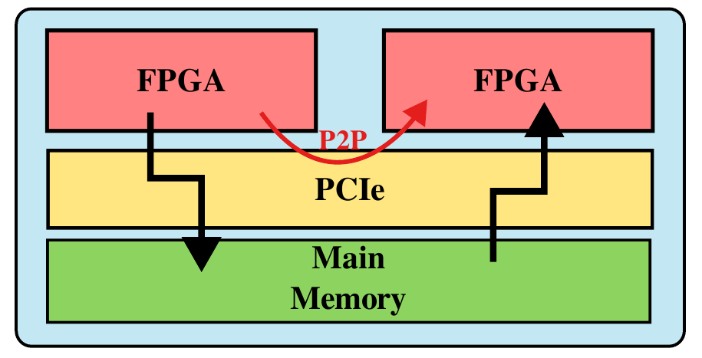
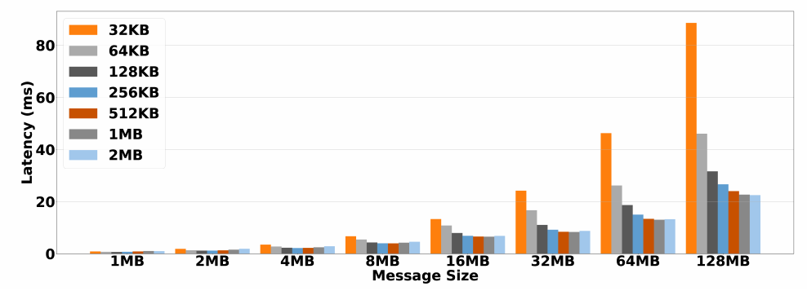
Optimized MVAPICH-FPGA Design
P2P transfers enable data to travel between devices over PCIe without entering host memory
Extension of OMB for FPGA-based systems

Slide 33
Outline
Brief Overview of the MVAPICH Project
Features of Latest Release
Upcoming Features
MVAPICH and MVAPICH-Plus 4.0 with support for MPI 4.1
MVAPICH-Plus for AI-Accelerator Chips (Habana/Gaudi)
MVAPICH and OMB for FPGA
MPI4DL for Deep Learning
Conclusions

Slide 34
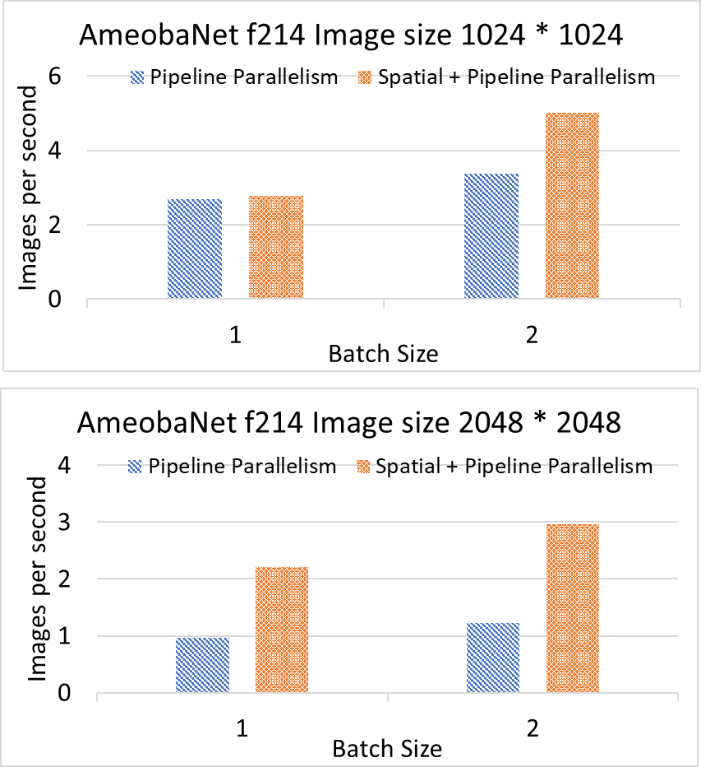
Upcoming Release: MPI4DL v0.5
MPI4DL v0.5 is a distributed and accelerated training framework for very high-resolution images that integrates Spatial Parallelism, Layer Parallelism, and Pipeline Parallelism.
Features:
Based on PyTorch
Support for training very high-resolution images
Distributed training support for:
Layer Parallelism (LP)
Pipeline Parallelism (PP)
Spatial Parallelism (SP)
Spatial and Layer Parallelism (SP+LP)
Spatial and Pipeline Parallelism (SP+PP)
Support for different image sizes and custom datasets.
Exploits collective features of MVAPICH2-GDR

Slide 35
Outline
Brief Overview of the MVAPICH Project
Features of Latest Release
Upcoming Features
MVAPICH and MVAPICH-Plus 4.0 with support for
MVAPICH-Plus for AI-Accelerator Chips (Habana/Gaudi)
MVAPICH and OMB for FPGA
INAM
MPI4DL for Deep Learning
Conclusions

Slide 36
Funding Acknowledgments
Funding Support by
Equipment Support by

Slide 37
Acknowledgments to all the Heroes (Past/Current Students and Staffs)
Current Students (Graduate)
N. Alnaasan (Ph.D.)
Q. Anthony (Ph.D.)
C.-C. Chun (Ph.D.)
N. Contini (Ph.D.)
K. S. Khorassani (Ph.D.)
R. Vaidya (Ph.D.)
J. Yao (P.hD.)
M. Han (M.S.)
A. Guptha (M.S.)
Current Research Scientists
M. Abduljabbar
A. Shafi
Current Faculty
H. Subramoni
P. Kousha (Ph.D.)
B. Michalowicz (Ph.D.)
B. Ramesh (Ph.D.)
K. K. Suresh (Ph.D.)
A. H. Tu (Ph.D.)
S. Xu (Ph.D.)
Q. Zhou (Ph.D.)
K. Al Attar (M.S.)
L. Xu (Ph.D.)
G. Kuncham (Ph.D.)
Current Software Engineers
N. Pavuk
N. Shineman
M. Lieber
Current Students (Undergrads)
J. Sulewski
T. Chen
Past Students
A. Awan (Ph.D.)
A. Augustine (M.S.)
P. Balaji (Ph.D.)
M. Bayatpour (Ph.D.)
R. Biswas (M.S.)
S. Bhagvat (M.S.)
A. Bhat (M.S.)
D. Buntinas (Ph.D.)
L. Chai (Ph.D.)
B. Chandrasekharan (M.S.)
S. Chakraborthy (Ph.D.)
N. Dandapanthula (M.S.)
V. Dhanraj (M.S.)
C.-H. Chu (Ph.D.)
Current Research Specialist
R. Motlagh
T. Gangadharappa (M.S.)
K. Gopalakrishnan (M.S.)
J. Hashmi (Ph.D.)
W. Huang (Ph.D.)
A. Jain (Ph.D.)
W. Jiang (M.S.)
J. Jose (Ph.D.)
M. Kedia (M.S.)
S. Kini (M.S.)
M. Koop (Ph.D.)
K. Kulkarni (M.S.)
R. Kumar (M.S.)
S. Krishnamoorthy (M.S.)
K. Kandalla (Ph.D.)
M. Li (Ph.D.)
P. Lai (M.S.)
J. Liu (Ph.D.)
M. Luo (Ph.D.)
A. Mamidala (Ph.D.)
G. Marsh (M.S.)
V. Meshram (M.S.)
A. Moody (M.S.)
S. Naravula (Ph.D.)
R. Noronha (Ph.D.)
X. Ouyang (Ph.D.)
S. Pai (M.S.)
S. Potluri (Ph.D.)
K. Raj (M.S.)
R. Rajachandrasekar (Ph.D.)
D. Shankar (Ph.D.)
G. Santhanaraman (Ph.D.)
N. Sarkauskas (B.S. and M.S)
N. Senthil Kumar (M.S.)
A. Singh (Ph.D.)
J. Sridhar (M.S.)
S. Srivastava (M.S.)
S. Sur (Ph.D.)
H. Subramoni (Ph.D.)
K. Vaidyanathan (Ph.D.)
A. Vishnu (Ph.D.)
J. Wu (Ph.D.)
W. Yu (Ph.D.)
J. Zhang (Ph.D.)
Past Research Scientists
K. Hamidouche
S. Sur
X. Lu
Past Senior Research Associate
J. Hashmi
Past Programmers
A. Reifsteck
D. Bureddy
J. Perkins
B. Seeds
Past Post-Docs
D. Banerjee
X. Besseron
M. S. Ghazimirsaeed
Past Research Specialist
M. Arnold
J. Smith
H.-W. Jin
J. Lin
M. Luo
A. Ruhela
J. Vienne
H. Wang
E. Mancini
K. Manian
S. Marcarelli

Slide 38
Thank You!
panda@cse.ohio-state.edu
Network Based Computing
Laboratory
Network-Based Computing Laboratory
http://nowlab.cse.ohio-state.edu/
The High-Performance MPI/PGAS Project
http://mvapich.cse.ohio-state.edu/
The High-Performance Big Data Project
http://hibd.cse.ohio-state.edu/
The High-Performance Deep Learning Project
http://hidl.cse.ohio-state.edu/

